Slide 1

Overview and Data Science or Science of Data
Brian Wright, PhD
brianwright@virginia.edu
Assistant Professor
Data Science Institute

Slide 2

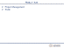
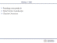
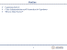
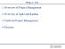

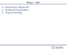
Lecture Links
Week 1
Week 2
9.2
9.4
Week 3
9.9
9.11

Slide 3
Outline
Capstones Q & A
Class Administration and Connection to Capstones
What is Data Science?

Slide 4
Class Administration/Tech Stack
Syllabus and files are on Github
https://github.com/NovaVolunteer/Practice_Application_DS
Use Collab for submission of graded material
Slack Channel:
Use for exchanging ideas, sharing interesting content or asking questions
Class is directly linked to your Capstone
Apply the content to development of the capstone project
Review Schedule and Requirements
Trello

Slide 5

Data Science Overview
What is Data Science?
X
X
X
Source: https://honingds.com/blog/intro-to-data-science/

Slide 6
Data Science Overview
Why the surge in Data Science?
Increases in Computing Power - Processor Speed/Cloud Computing
Availability of Data – Storage Capacity
Open Source Tools – Incredibly dedicated and heavily vested communities supporting technology advancement

Slide 7
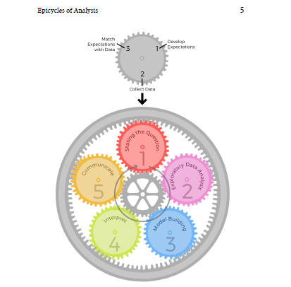
Data Science Overview
Roger Ping: Art of Data Science

Slide 8
7
6
2
5
3
4
http://sudeep.co/data-science/Understanding-the-Data-Science-Lifecycle/

Slide 9
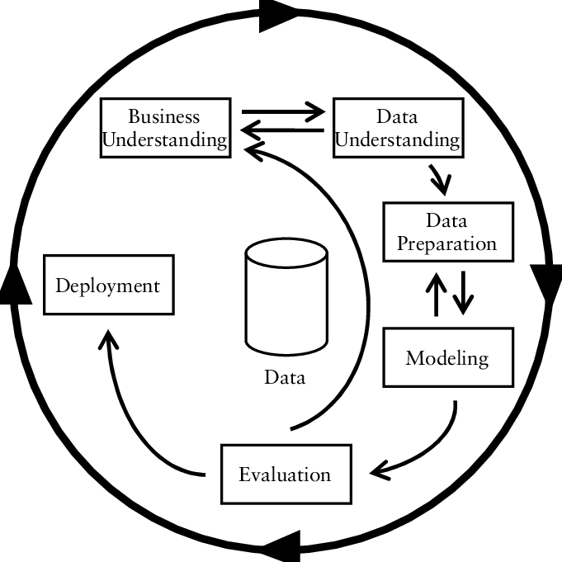
Data Science Overview
CRISP-DM
https://www.researchgate.net/figure/CRISP-DM-process-model_fig3_261307514

Slide 10

Microsoft
https://jenstirrup.com/2017/07/01/whats-wrong-with-crisp-dm-and-is-there-an-alternative/

Slide 11
Exercise: What you think? Get in Groups of Five What about these makes sense, what doesn’t and what would you draw…

Slide 12
LIFECYCLE OF THE CLASS
Question Development/Business Understanding
Project Charter
Project Proposal
Data Acquisition/Storage
Modelling Building
Data Exploration
Communications
Data Cleaning
Feature Engineering
Capstone Poster
Group Paper SEEDS
Group Presentations
Group Presentations
Final Presentations

Slide 13
Epicycle of Data Science
Setting Expectations,
Collecting information (data), comparing the data to your expectations, and if the expectations don’t match,
Revising your expectations or fixing the data so your data and your expectations match.

Slide 14
Data Science Overview
Match Expectations with Data
Develop Expectations
3
1
2
Can be the hardest, maybe not the most time consuming
Collect Data
Stating the Question

Slide 15
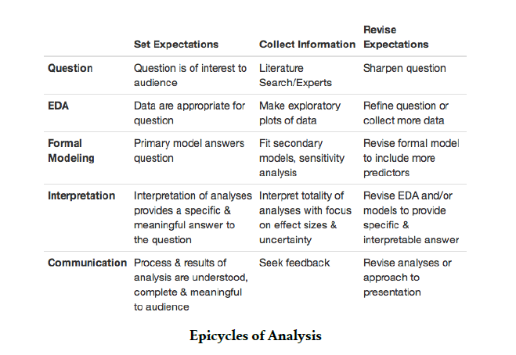
Epicycle at Each Stage

Slide 16
Research Practices Key to Question Definition/Expectations

Slide 17
Research Techniques
Create an informal Literature Review or business case review for the central topic of the issue being addressed
Subscribe to online journals or newsletters
Stay current with policy or regulatory changes in your field

Slide 18
Research Techniques
Have discussions with peers
Pull information from your previous work
Membership in professional groups
Attend conventions or training sessions

Slide 19
Research Techniques
Seek additional educational opportunities (brick and mortar or online)
Subscribe to subject specific listservs
Meet with a Librarian

Slide 20
Literature/Research Review
Gathering information on your question in a structured manner
Create an outline of sources
Reduce resources to key sources
Summarize the themes of these elements

Slide 21
Research Outcomes
Gives your recommendations and insight substance
Increases your value as a knowledge worker
Makes your organization more competitive from an intellectual capital standpoint
Allows for you to provide the maximum amount of value in your chosen field
Allows to become ever more specialized
Stay on top of the latest trends and insights
Creates a foundation for intuition and critical thinking in your chosen field

Slide 22
As a result of the ever-expanding knowledge economy and emphasis on intellectual capital driving divisions of labor resulting in hyper specialization the need to establish high quality research habits is a critical step for anyone wanting to stay competitive in his/her chosen field.

Slide 23
Week 2 – 9.04
Framing your projects
Data Science Landscape
Charter Overview

Slide 24
Exercise
Get into your capstone groups
Discuss what you think the expectation are for your project and complete the following statement:
This will be a successful project if…

Slide 25
Charter Review

Slide 26
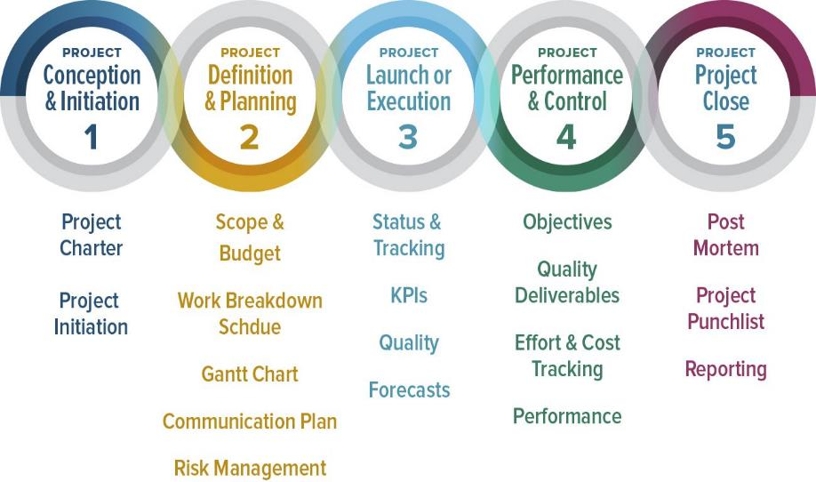
Project Management Documentation
https://www.smartsheet.com/blog/demystifying-5-phases-project-management

Slide 27
Assignment
Find a potential data science dream job, share on slack and be prepared to discuss in class on the 9th

Slide 28
Week 2 – 9.04
Data Resources: Jenn Huck
Contract Person: Bill Schoelwer
Teamwork

Slide 29
Problem Solving and Teamwork

Slide 30
General Problem Solving Hints
There may be more than one right answer (or none at all)
There may be more than one path to the right answer
Use the right tool for the job
Use approximations
Don’t let yourself get stuck
Try thinking of something completely different

Slide 31
Specific Problem Solving Strategies
Draw a picture
Make a table
Graph the data
Re-organize the information
Solve a simplified version of the problem
Use logic or approximations to do a “gut-check” against your answers

Slide 32
The Four Questions Problem Solving
What do I know?
What am I looking for?
What else do I need to find it?
What do I expect?

Slide 33
Answer the Four Questions
American Pharaoh won the Triple Crown. He won the Belmont, a 12 furlong track, with a time of 2:26.65, the Kentucky Derby, a 10 furlong track, with a time of 2:03.02, and the Preakness Stakes, a 9.5 furlong track, with a time of 1.58.46. What was his average speed in mph?

Slide 34
Now Solve the Problem
Work in your Capstone Teams to code the solution with an output that reads “[Horse’s Name] averaged [ x ] mph across the three triple crown races.
American Pharaoh won the Triple Crown. He won the Belmont, a 12 furlong track, with a time of 2:26.65, the Kentucky Derby, a 10 furlong track, with a time of 2:03.02, and the Preakness Stakes, a 9.5 furlong track, with a time of 1.58.46. What was his average speed in mph?

Slide 35
Week 3 - 9.09
Data Science Dream Job
Landscape of Data Science
Technical Presentations
Proposal Writing

Slide 36
Week 3 - 9.09
Last Week?

Slide 37
Dream Job
Who wants to share?
What trends did you notice?
What kind of jobs seemed the most appealing?
What kind of jobs did you like the least?
Do we think jobs will become more specialized over time?
https://github.com/JasonYao/NLP-twitter-stock-trader/blob/master/README.md

Slide 38
Landscape of Data Science

Slide 39
Types of Data Scientists
Those strong in statistics: they sometimes develop new statistical theories for big data, that even traditional statisticians are not aware of. They are expert in statistical modeling, experimental design, sampling, clustering, data reduction, confidence intervals, testing, modeling, predictive modeling and other related techniques.
Those strong in mathematics: NSA (national security agency) or defense/military people working on big data, astronomers, and operations research people doing analytic business optimization (inventory management and forecasting, pricing optimization, supply chain, quality control, yield optimization) as they collect, analyses and extract value out of data.
Those strong in data engineering, Hadoop, database/memory/file systems optimization and architecture, API's, Analytics as a Service, optimization of data flows, data plumbing.

Slide 40
Types of Data Scientists
Those strong in machine learning / computer science (algorithms, computational complexity)
Those strong in business, ROI optimization, decision sciences, involved in some of the tasks traditionally performed by business analysts in bigger companies (dashboards design, metric mix selection and metric definitions, ROI optimization, high-level database design)
Those strong in production code development, software engineering (they know a few programming languages)
Those strong in visualization
Those strong in GIS, spatial data, data modeled by graphs, graph databases
Those strong in a few of the above.

Slide 41
Fields of Focus
Biotech (Genome)
Finance (Time-Series/Forecasting)
Health Care (Survival Analysis/Fraud Detection)
Cyber Security (Defense Against Attacks)
Geospatial Analysis (Climate Change/Earthquakes/Intelligence)
What else….

Slide 42
Data Science Overview
What do Data Scientists actually do anyway?
https://www.kaggle.com/surveys/2017

Slide 43
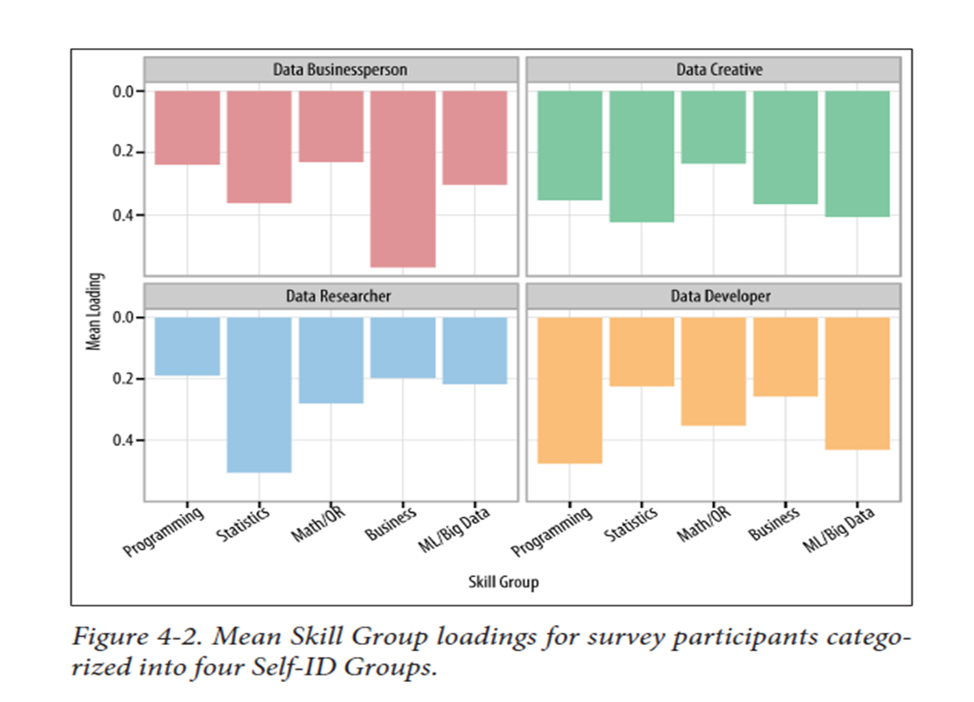

Slide 44
Be thinking about what type of Data Scientists you are/or want to be and what field of specialty in which you would like to work.
http://survey.datacommunitydc.org/reset

Slide 45
Importance of Data Science Communications
Business Broadway surveyed over a 1,000 data scientists across a variety of domains to determine the top 10 skills for different data science roles:
Business Manager
Developer
Creatives
Researcher
Where do you think communications falls for Developer and Reseacher?
Poll…next slide

Slide 46
Quick Poll
Join at
slido.com
#Y676
Notes:
https://admin.sli.do/event/pm3yh3cy/polls

Slide 47
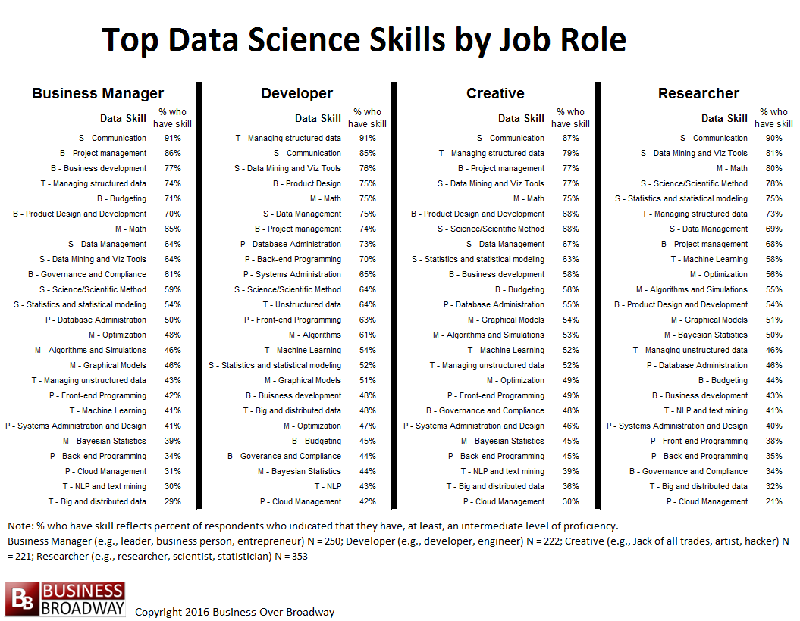

Slide 48
Key Points
Data visualization can be seen as the product data science professionals are generating prior to deployment
Communications can be just as important as technical skills across a variety of data science focus areas

Slide 49
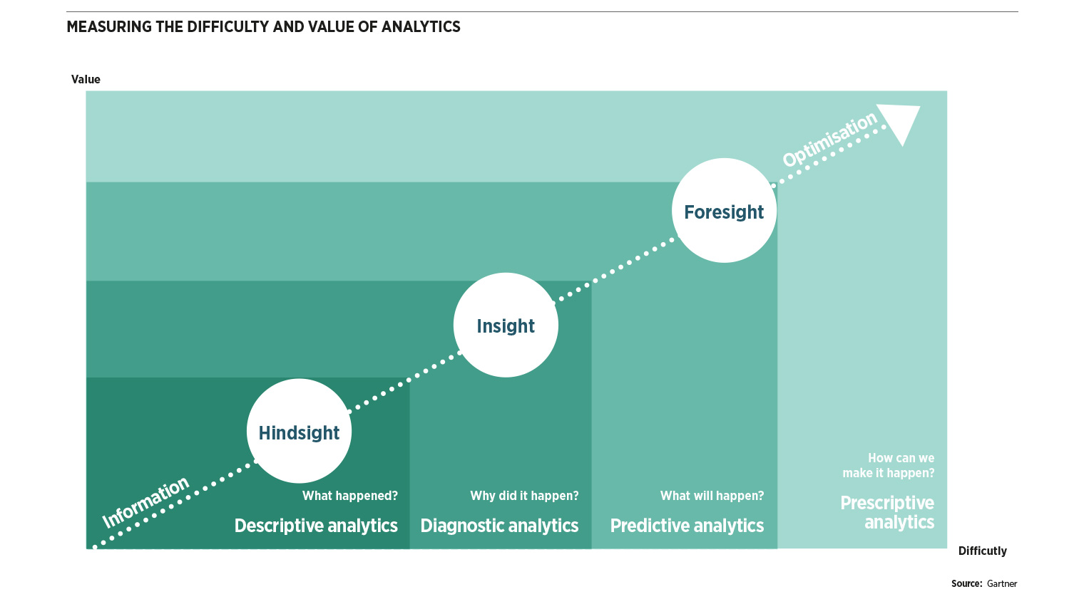
Data Science Overview: Data Analytics (Science) Levels
X
Cumulative Effect
X
Knowledge Requirement

Slide 50
Week 3 - 9.11
Technical Presentations
Proposal Writing

Slide 51
Technical/Proposal Presentations
Elements of Your Presentation:
Title Slide
Problem and Motivation
Background/Previous Work
Data Overview (if you know)
Potential Solution – Models/Analysis
Final Product/Expected Outcome – (Dev Ops)
10 slides or less/6 to 8-minute presentations

Slide 52
Technical/Proposal Presentations
Tips:
No Code
Think of the presentation as a story: each slide should contribute to the story and there should be an arch

Slide 53
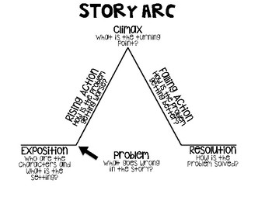
Technical/Proposal Presentations
Sketch out the presentation before you build it using this format
https://www.teacherspayteachers.com/Browse/Search:arc%20of%20the%20story%20graphic%20organizer

Slide 54

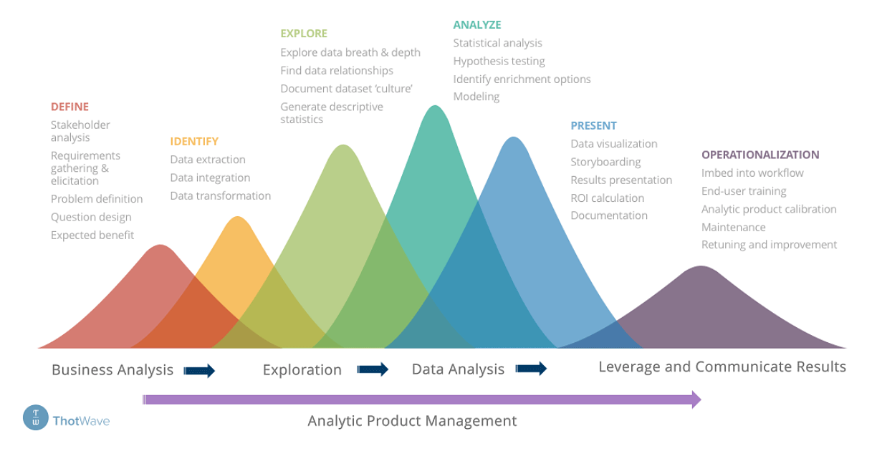
Technical/Proposal Presentations: Use Lifecycle as Arch
7
6
2
5
3
4

Slide 55
Technical/Proposal Presentations
Tips:
Don’t include a graphic if it adds no value
No graphic for graphics sake!
Keep slides simple
Be ready for detail question, include speaker notes if needed for ease of reference
Slides should frame your conversation not be the conversation
Don’t just read the slides
Make text readable from the back of the room

Slide 56
Technical/Proposal Presentations
Tips:
Speak slowly
Make eye contact with the audience
Use a pointer and slide clicker as needed
Practice with your team

Slide 57
Proposal Writing

Slide 58
Proposal Writing
Good proposal stems from a good concept. The best proposals are those to which the reviewers respond, “Of course, I wish I had thought of that!” – National Science Foundation, Directorate for Education and Human Resources.

Slide 59
Technical/Proposal Presentations
Problem Statement Definition
Background Research
Writing Assignments and Milestones
Budget preparation and Approval
Schedule preparation and Approvals

Slide 60
Technical/Proposal Presentations
Review Outline

Slide 61
Week 3 - 9.11
Overview of Project Management
Overview of Agile and Kanban
Trello for Project Management
Exercise

Slide 62
On Monday?

Slide 63

What is Project Management?
Framework for Managing a Project from Start to Finish
Discipline – but an art, not a science

Slide 64

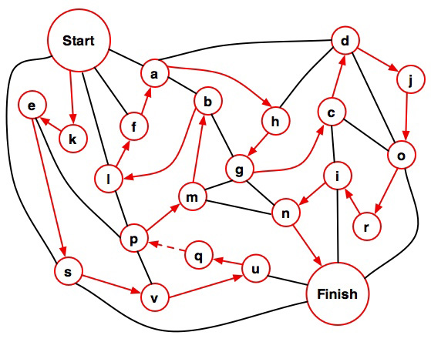
Project Management Principles
1.
2.
3.

Slide 65
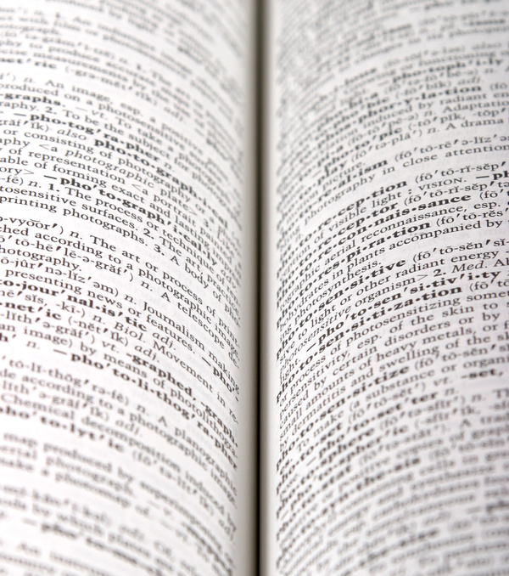
Definition of a Project
- A temporary endeavor undertaken to create a unique product, service, or result.
Project
Temporary / Not Ongoing
Definite beginning and end
Does not mean a short duration
Unique
Outcome is a unique deliverable
Could come in the form of either products, services or results

Slide 66
Project Lifecycle: Five(ish) Phases
Initiating
Planning
Monitoring & Controlling
Executing
Closing

Slide 67
PM in Practical Terms
Define
Clarify the request and objectives
Plan
Develop the specific approach
Initiating
Planning
Monitoring & Controlling
Manage
Task, action, communication & resource management
Review
Were expectations met?
Executing
Closing

Slide 68
Initiating
7
Planning
Executing
6
2
Closing
5
3
4

Slide 69



Triple Constraints
Triple
Constraints
Time
Scope
~ Good, Fast, or Cheap: You Can Only Pick Two
Dates
Deliverables
Dollars
Resources
~ Managing these is the primary responsibility of the PM
$

Slide 70

Keys to Success
Clear agreement at outset of the project
Good communications
Groundwork/Realistic Expectations
Thoughtful Project Plan
Knowledgeable team members
Avoiding Scope Creep
Saying No
Project Closeout

Slide 71
Methods

Slide 72
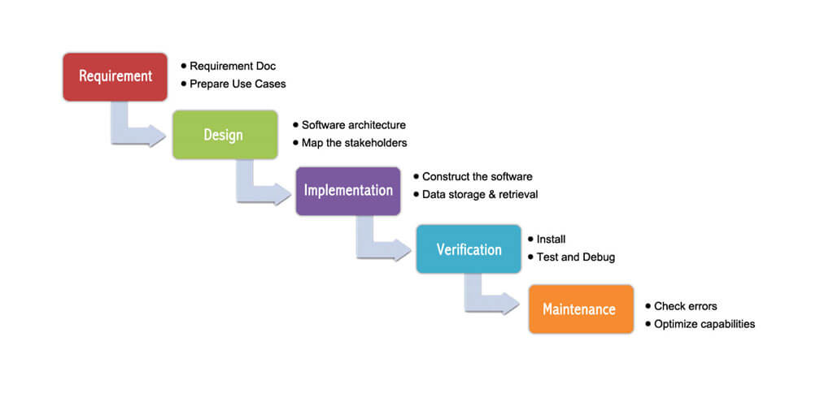
Approaches: Waterfall and Agile
Waterfall is the typical linear approach to project management defined by sequential steps:
Source: https://www.orangescrum.com/tutorial/introduction-to-project-management/project-management-methodologies

Slide 73
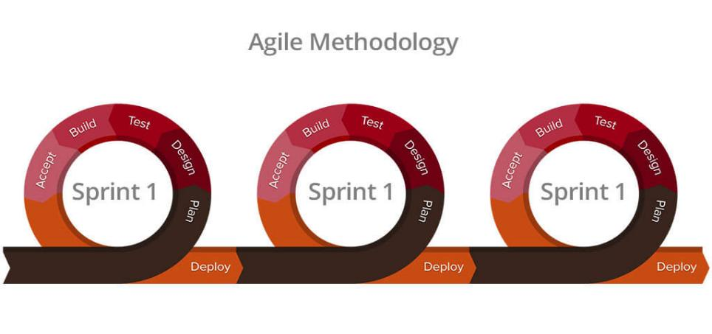
Approaches: Waterfall and Agile
Agile instead comprised of “sprints” designed around key components of the project.
Source: https://www.orangescrum.com/tutorial/introduction-to-project-management/project-management-methodologies

Slide 74
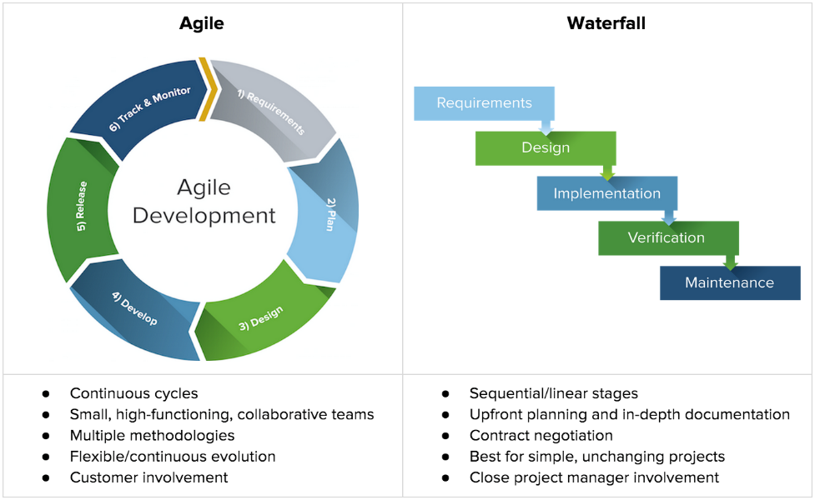
Approaches: Waterfall and Agile
Source: https://www.centriq.com/blog/why-it-professionals-need-to-learn-agile-project-management/

Slide 75
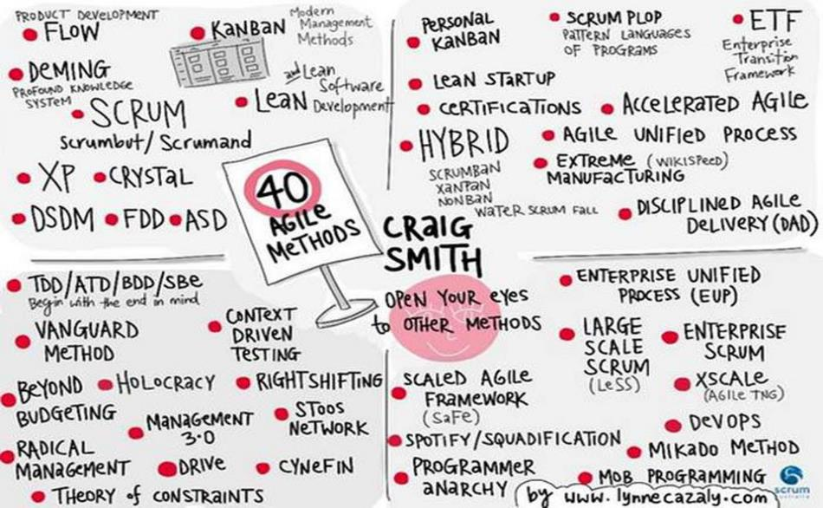
Agile Methods
Graphic by Lynne Cazaly from a talk by Craig Smith: Slides and video are available here: https://craigsmith.id.au/2015/12/03/yow-2015-40-agile-methods-in-40-minutes/
Notes:
PLANNING IS TIME WELL SPENT!

Slide 76
Agile Methods
System to rapidly iterate to allow for quick adoption to change
Small dynamic teams
Individuals and interactions are critical
Continuous collaboration with the customers or stakeholders
Not about getting more work done faster, instead we want to get more value with less work

Slide 77
Agile Methods
Supported by this idea of the minimum viable product (MVP) for your idea and then build out as necessary
MVP to allow for the maximum amount of learning to take place at quick as possible
Think big and but plan small
Failing fast is key – “rapid iterative failure yields eventual success much faster”¹
¹ Maxmeister, M. (2018). Trello for Project Management

Slide 78
Agile Methods and Data Science
Originally created for software development…so some adoption to data science is necessary
We want to be able to respond to opportunities and challenges that are presented from the data²
Your data’s opinion must be taken into consideration!
This could mean changing your question, success metric, analysis method and even overall goals of the project
² Source: https://www.oreilly.com/ideas/a-manifesto-for-agile-data-science

Slide 79
Agile Methods and Data Science
Think about the projects you’ve completed already…
Data is parsed, reshaped, combined and reformatted
Visualization often take several integrations before real meaning can be generated
Machine learning algorithms require lots of feature engineering and hyperparameter tuning
…all completed with iterations

Slide 80
Agile Methods and Data Science
A difference between agile for software is to remember the Science in Data Science²
Not necessarily developing a app feature but instead identifying what feature to add to the app
We can look at each of these iterations as experiments designed to help us better understand our problem or question being addressed
At the beginning we need to prioritize learning/information gained, versus business utility until uncertainty is reduced
Documentation of the process along the is a key component to what is getting pushed to the client or stakeholder
Need to be able to explain the decisions that are being made

Slide 81
Key Takeaways
Project management technics help us be more efficient
Agile in particular works to ensure we are developing products that align with stakeholder needs through a flexible iterative process
Agile for Data Science works because of the uncertainty associated with data focused projects
Listen to your data and don’t forget the Science in Data Science, think of the iterations as experiments
Develop testable hypothesizes for the various stages of the project
Incorporating this new model approach will improve precision to over 80% and maintain recall at 90%
Notes:
Just in case you need a quick precision/recall reference: Suppose a computer program for recognizing dogs in photographs identifies 8 dogs in a picture containing 12 dogs and some cats. Of the 8 identified as dogs, 5 actually are dogs (true positives), while the rest are cats (false positives). The program's precision is 5/8 while its recall is 5/12. So precision is the rate at which the algo is correct when identifying the target and recall is the overall ability of the algo to capture all the targets correctly. So in this example the algo when identifying a dog does so correctly 60% of the time but overall only identifies 40% of dogs. Meaning 60% of dogs go unidentified and there’s a 40% chance when identified that’s it’s wrong.

Slide 82
Quick Question
How could you have applied these concepts in the projects you’ve completed?
Notes:
Just in case you need a quick precision/recall reference: Suppose a computer program for recognizing dogs in photographs identifies 8 dogs in a picture containing 12 dogs and some cats. Of the 8 identified as dogs, 5 actually are dogs (true positives), while the rest are cats (false positives). The program's precision is 5/8 while its recall is 5/12.

Slide 83
Kanban for Agile
Goal is to limit the amount of excess “work in progress” WIP
Kanban literally means “visual card”
Toyota used this process to limit the amount of excess inventory on the manufacturing floor
Actually does not have short iterative processes, but instead controls the amount of work by emphasizing incremental tasks which essentially serve as the iterations

Slide 84
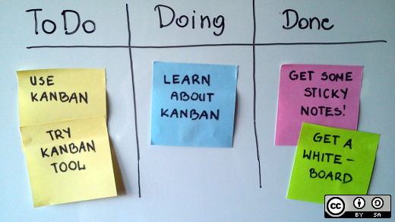
Kanban for Agile
Simplest board possible
Source: https://opensource.com/alternatives/trello

Slide 85
Kanban for Agile
Quick Example
https://trello.com/b/sIIyR0JN/dc2-board-board

Slide 86
Kanban Research
Saltz, Shamshurin, Crowston (2017) “Comparing Data Science Project Management Methodologies via a Controlled Experiment”
Compared four different methods for managing data science projects being used by graduate data science student teams.
Agile Scrum
Agile Kanban
CRISP
Baseline: chaos

Slide 87
Kanban Research
Results showed Kanban was the most effective across the various metrics and surveys used to assess team performance.
Specifically the authors suggest “Kanban helped with student teamwork skills and fostered collaboration. It also appears to have a low barrier to entry with no significant training required.”
An Industry Case Study: Sjøberg (2012) “Quantifying the Effect of Using Kanban versus Scrum” found that after implementing a Kanban approach the company being analyzed reduced lead time by nearly 50%, bugs dropped by 10% and overall productivity improved.

Slide 88
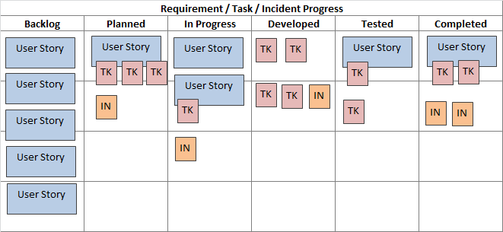
Kanban Methods: Tradition Software
Puts the whole project in one place
User Story – Essentially a task or could be a hypothesis
Place a User Story into the workflow once another is completed
Rule 2X work workflow, with X being the data scientists

Slide 89
Trello
Let’s Take a Look
Establish a Trello account
Explore Functionality
Link to GitHub
Notes:
PLANNING IS TIME WELL SPENT!

Slide 90
Exercise
In your project teams develop initial board using the Kaban approach
Incorporate known milestones from this class

Slide 91
Sources
Agile for Data Science Overview (Excella): https://solutions.excella.com/making-agile-work-for-data-teams-presentation
Agile Manifesto for Data Science: https://www.oreilly.com/ideas/a-manifesto-for-agile-data-science
Maxmeister, M. (2018). Trello for Project Management

Slide 92
Week 4 - 9.16
Target Setting
Case Study
GitHub Overview

Slide 93
Andrew Ng a famous AI-pioneer, teaches that every Data Science project should start with defining a clear measurable metric. He suggests that in large part this metric should define the success and failure of the project. As a consequence, this goal steers the direction of the project.

Slide 94
Target Setting
Target Setting – Agreed upon metric that allows for clear objectives to be set in consideration of the business model and the data at hand.
Can be tied to a tradition evaluation measure or an internal business metric
Best case might be that it’s both and in many cases necessitated by the situation.

Slide 95
Target Setting
Tips for Discovering your project Target
Understand what is currently being done (Current Performance)
Talk to experts internally/research review
Preview your data and build simple models based on samples

Slide 96
Target Setting
Common output/evaluation metrics
Regression: RSME/MAE
Classification: AUC/ROC/Precision&Recall/Confusion Matrix/F1

Slide 97
Assessment Measures
Regression Models: RMSE and MAE
RSME – Same as above only the square root is taken to put the error back in terms of the dependent variable
Sensitive to large errors, the variance of the error distribution impacts RSME
MAE – The same approach only taking the absolute value instead of squaring
Easier to interpret

Slide 98
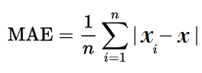
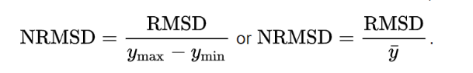
Equations
Also can Normalize RSME to compare between datasets
Notes:
Can also take the average of the X values vice the range to normalize the output

Slide 99
Decision Trees: Evaluation: Receiver Operating Curve or Area Under the Curve
ROC and AUC are two very common approaches for measuring the performance of classification models
Essentially both these measure the misclassification error rate associated with your model
A Confusion Matrix is a good tool for understanding how accurate you model is classifying and can be used to build ROC

Slide 100
Decision Trees: Evaluation: Confusion Matrix and threshold
Let‘s use intruder detection as an example
Say we have 135 emails entering our system and we are trying to detect whether they are fraudulent or not
We use lots of criteria – source, subject, if they came from a prince…
Generate probability measures as a result of our tree algorithm to determine the likelihood that any one of these emails fraudulent
The cutoff point that is predetermined in the tree at 50%
 | Predictive Class
Actual Class |  | Positive Fraud | Negative Not Fraud
 | Positive Fraud | True Positive 10 | False Negative 7
 | Negative Not Fraud | False Positive 22 | True Negative 96

Slide 101
Decision Trees: Evaluation: Confusion Matrix and threshold
Let’s consider the extremes: what if we set the threshold to 0?
Means that everything is captured as Fraud and no ever gets an email again!
 | Predictive Class
Actual Class |  | Positive Fraud | Negative Not Fraud
 | Positive Fraud | True Positive 17 | False Negative 0
 | Negative Not Fraud | False Positive 118 | True Negative 0

Slide 102
Decision Trees: Evaluation: Confusion Matrix and threshold
Let’s consider the extremes: what if we set the threshold to 100?
Means nothing is fraud and now everyone is getting rich off of Arabian princes
 | Predictive Class
Actual Class |  | Positive Fraud | Negative Not Fraud
 | Positive Fraud | True Positive 0 | False Negative 17
 | Negative Not Fraud | False Positive 0 | True Negative 118

Slide 103
Decision Trees: Evaluation: Confusion Matrix and threshold
We can also predict the accuracy of our model using this information:
True Positive Rate (TPR) = 10/(10+22) = .45
False Positive Rate (FDR) = 7/(7+96) = .06
 | Predictive Class
Actual Class |  | Positive Fraud | Negative Not Fraud
 | Positive Fraud | True Positive 10 | False Negative 7
 | Negative Not Fraud | False Positive 22 | True Negative 96
Notes:
Just in case you need a quick precision/recall reference: Suppose a computer program for recognizing dogs in photographs identifies 8 dogs in a picture containing 12 dogs and some cats. Of the 8 identified as dogs, 5 actually are dogs (true positives), while the rest are cats (false positives). The program's precision is 5/8 while its recall is 5/12. So precision is the rate at which the algo is correct when identifying the target and recall is the overall ability of the algo to capture all the targets correctly. So in this example the algo when identifying a dog does so correctly 60% of the time but overall only identifies 40% of dogs. Meaning 60% of dogs go unidentified and there’s a 40% chance when identified that’s it’s wrong.

Slide 104
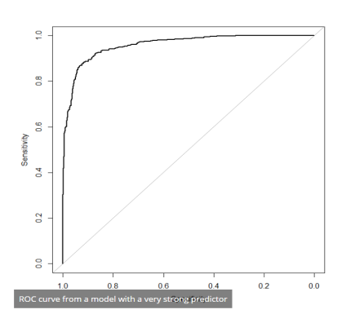
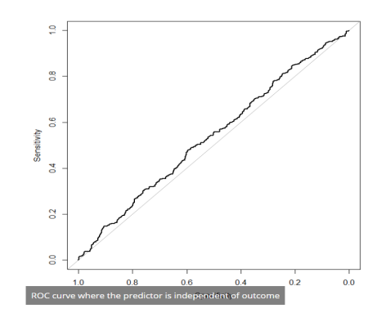
Decision Trees: Evaluation: ROC
ROC curve is essentially a graphical representation of the adjusted threshold values of the confusion matrix, below are two examples

Slide 105
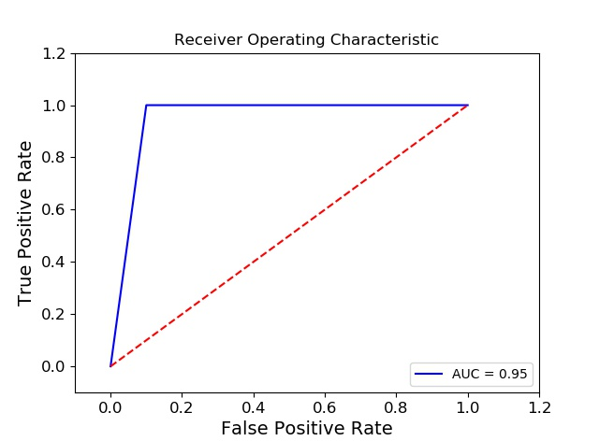
Decision Trees: Evaluation: Code ROC
These two data points can then be used to begin to develop a Receiver Operating Characteristic Curve or ROC curve
True Positive Rate (TPR) = 10/(10+22) = .45 = y-axis
False Positive Rate (FDR) = 7/(7+96) = .06 = x-axis

Slide 106
Decision Trees: Evaluation: Code ROC

Slide 107
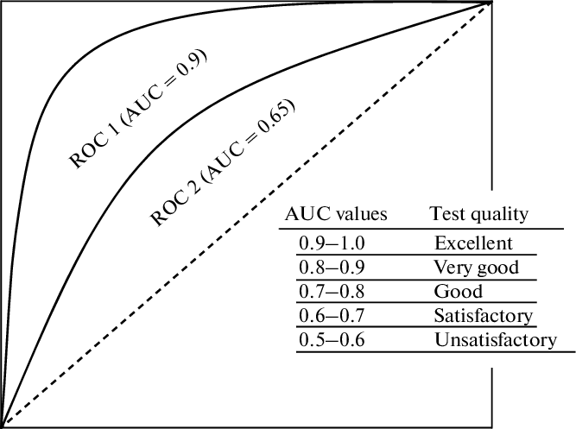
ISSN 19907508, Biochemistry (Moscow) Supplement Series B: Biomedical Chemistry, 2013, Vol. 7, No. 3, pp. 179–186. © Pleiades Publishing, Ltd., 2013. Original Russian Text © O.P. Trifonova, P.G. Lokhov, A.I. Archakov, 2013, published in Biomeditsinskaya Khimiya.

Slide 108
Decision Trees: Evaluation: Confusion Matrix and threshold
We can use this information to determine precision and recall, common metrics used for classification problems
Recall = TP/(TP+FN) = 10/10+7 = 10/17 = .59 (Ability to identify the target)
Precision TP/(TP+FP) = 10/(10+22) = 10/32 = .32 (Ability to identify relevant targets)
 | Predictive Class
Actual Class |  | Positive Fraud | Negative Not Fraud
 | Positive Fraud | True Positive 10 | False Negative 7
 | Negative Not Fraud | False Positive 22 | True Negative 96
Notes:
Just in case you need a quick precision/recall reference: Suppose a computer program for recognizing dogs in photographs identifies 8 dogs in a picture containing 12 dogs and some cats. Of the 8 identified as dogs, 5 actually are dogs (true positives), while the rest are cats (false positives). The program's precision is 5/8 while its recall is 5/12. So precision is the rate at which the algo is correct when identifying the target and recall is the overall ability of the algo to capture all the targets correctly. So in this example the algo when identifying a dog does so correctly 60% of the time but overall only identifies 40% of dogs. Meaning 60% of dogs go unidentified and there’s a 40% chance when identified that’s it’s wrong.

Slide 109

Target Setting
https://en.wikipedia.org/wiki/F1_score

Slide 110
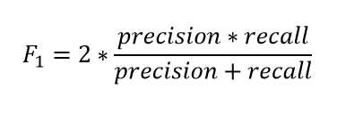
Target Setting
We can then use R and P to determine F1 (harmonic mean, range between 1 and 0)
Recall = TP/(TP+FN) = 10/10+7 = 10/17 = .59 (Ability to identify the target)
Precision TP/(TP+FP) = 10/(10+22) = 10/32 = .32 (Ability to identify relevant targets)
F1 = 2 * (.32*.59)/(.32+.59)
= 2 * .207
= .41
Notes:
A classifier with a precision of 1.0 and a recall of 0.0 has a simple average of 0.5 but an F1 score of 0

Slide 111
Quick Example in R

Slide 112
Case Study

